Slide 1
Learn and Help End User Manual
www.learnandhelp.com
(learnandhelp.Jasthi.com if you want to reference the links)
Siva Jasthi, Ph.D.
Siva.Jasthi@metrostate.edu

Slide 2
Overview
Learn and Help 3.0 https://learnandhelp.jasthi.com/
(www.learnandhelp.com)
Overview of the initiative
Learning
Helping
As User
New Views / Capabilities
As Administrator
New Functionality Added
Other Changes Made

Slide 3


Learn Programming &
Help Setting up Libraries:
Double Impact
Empower your child with essential coding skills while making a meaningful difference.
Join our unique program that combines computational thinking with social impact across India.
by Siva Jasthi

Slide 4
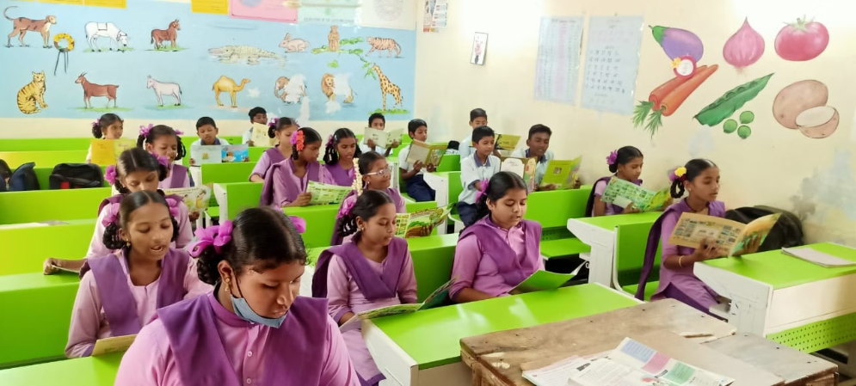
The "Learn and Help" Vision
Master Programming
Create Libraries
Double Impact
Your child will develop crucial computational thinking and coding skills through hands-on CS programming courses.
Together, you'll establish a fully-functional library at a school of your choice in Andhra Pradesh or Telangana.
This dual approach cultivates technical skills while fostering empathy and community service in young minds.

Slide 5
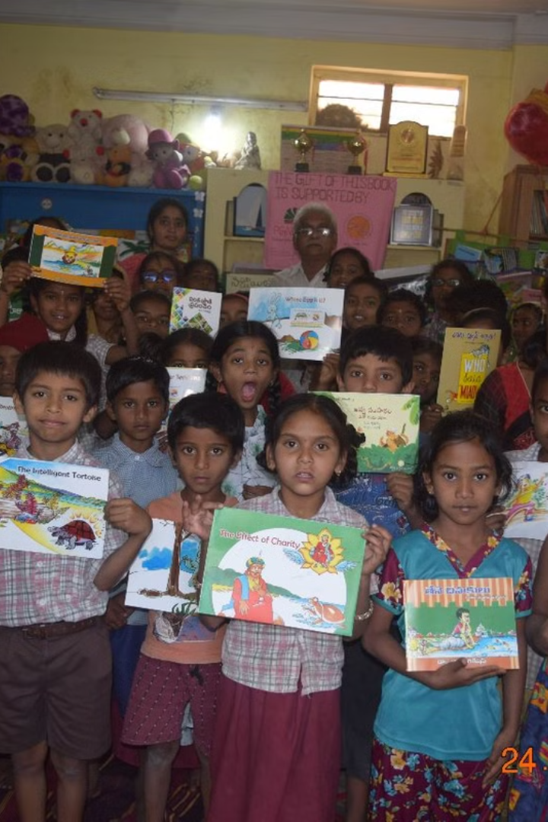
Our Growing Community
30
40
First Year
Second Year
Enthusiastic students joined our inaugural program batch.
Our community expanded through positive word-of-mouth.
52
Third Year
Almost all students came through parent referrals.

Slide 6
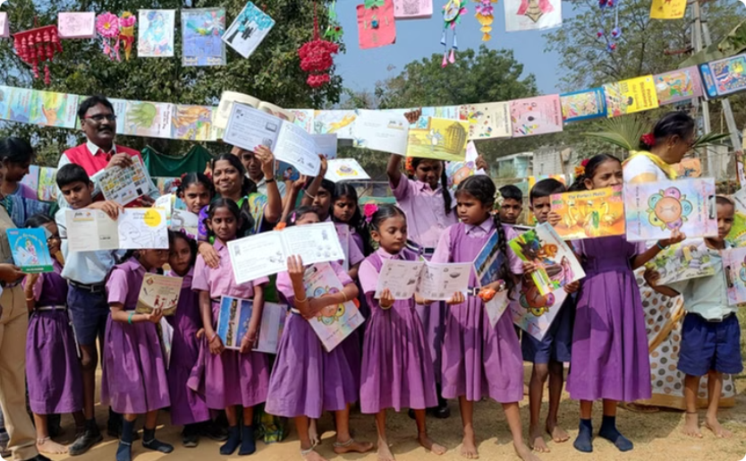
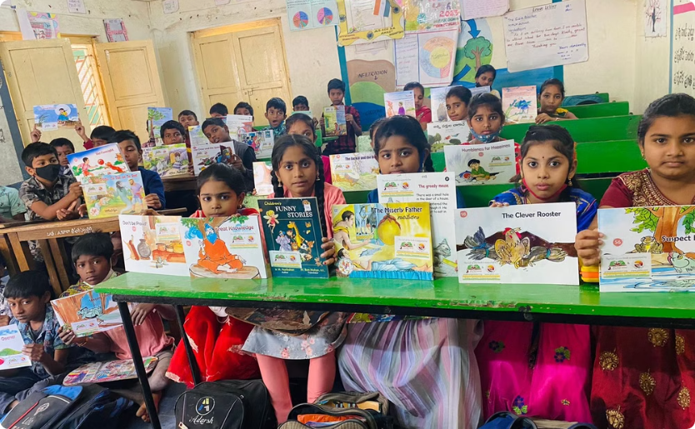
Certification Success Stories
Professional Recognition
Family Learning
Our curriculum prepares students for globally recognized Python certifications.
30 students and 4 parents earned Python Entry Level Certified Programmer status.

Slide 7
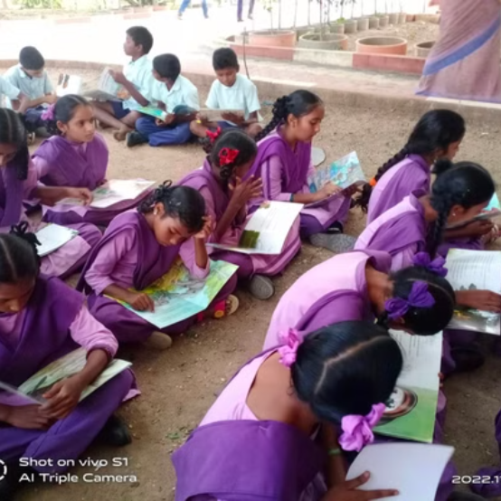
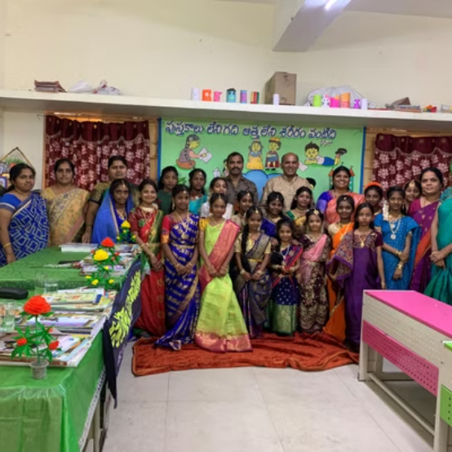

Library Impact
We've established 100 libraries across schools in Andhra Pradesh and Telangana! Each library opens doors to knowledge and imagination for hundreds of children.

Slide 8

Exciting Courses for 2025-26
1
Python 101
Morning and evening batches available for beginners to learn fundamentals.
2
Python for Data Science
Learn to analyze and visualize data using powerful Python libraries.
3
Python for Machine Learning
Build intelligent systems that can learn and make predictions.
4
Python for AI (2026-27)
Advanced course on Generative AI and Agentic AI coming soon!

Slide 9



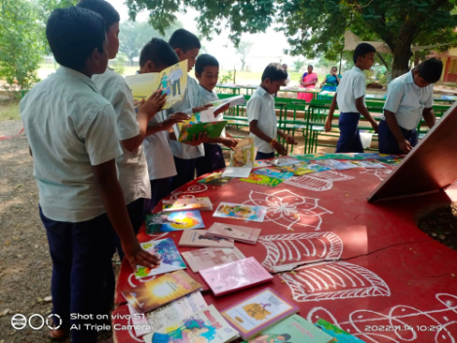
Join Our Journey!
Transform Lives
1
Make a lasting impact.
2
Build Libraries
Create knowledge hubs.
3
Learn Python
Master essential skills.
Have questions? Reach out to Siva Jasthi at Siva.Jasthi@gmail.com or call 651.276.4671. We're excited to welcome you to our growing community of learners and changemakers!

Slide 10
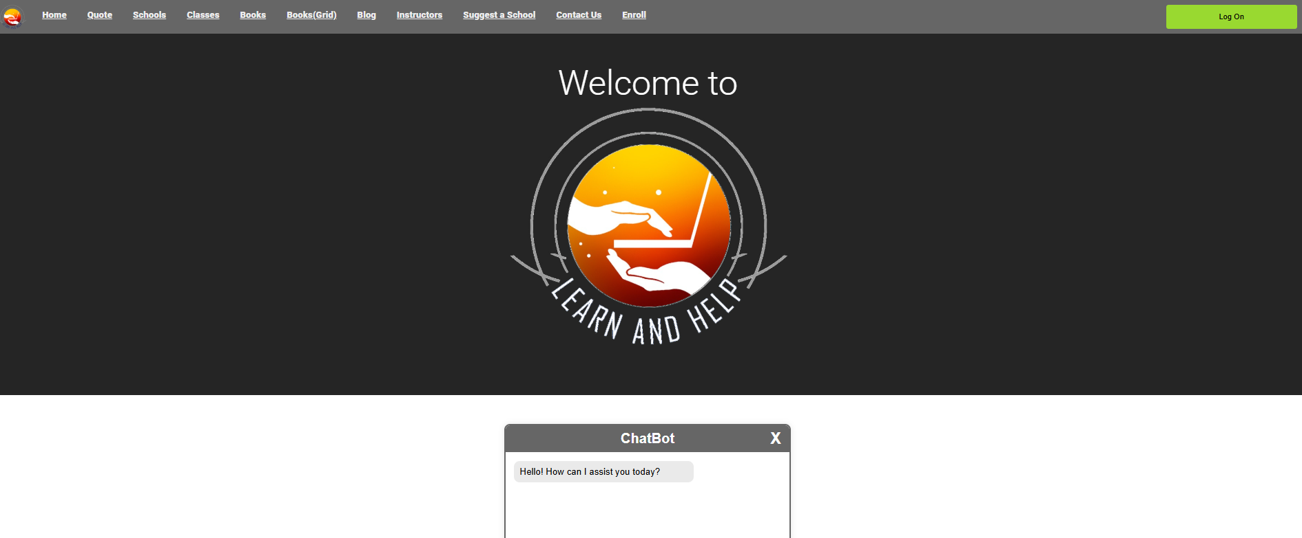
What do I need from you?
The User Interface is not good as it is designed by “programmers”
I need your help in
Redesigning every page with visually appealing layouts, fonts, and visuals.
I plan to give your designs as a project to my students in Summer of 2025
They will revamp the site to make it professional and visually appealing.

Slide 11
User / Visitor Functionality

Slide 12
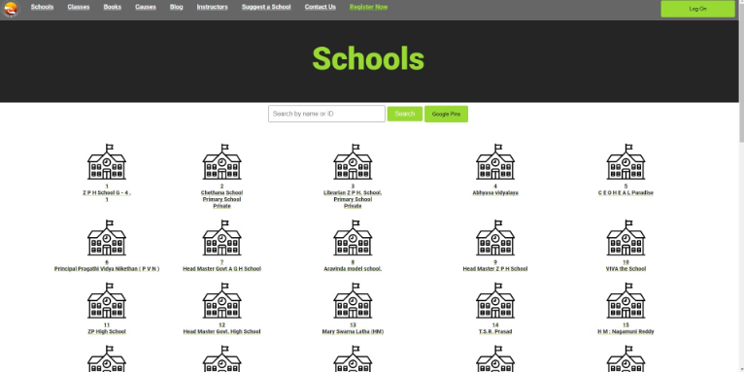
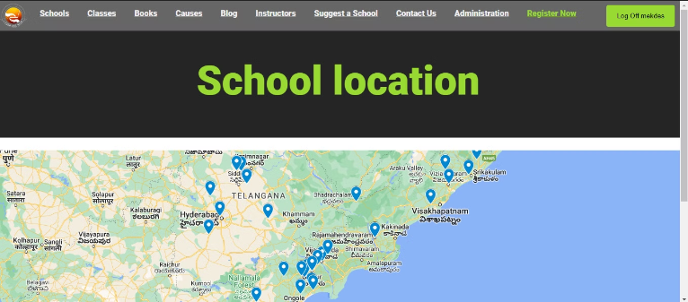
School
As a user/visitor
Here Users/Visitors can see a list of schools
When User/Visitor clicks on google pins it will take them to a google maps with all the school location on it.
What we implemented/changed
Implemented Google Pins Button to display a map with school locations fetched from a database, receiving easy access and visualization of relevant information.

Slide 13
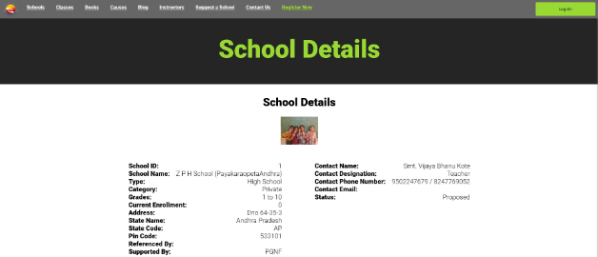
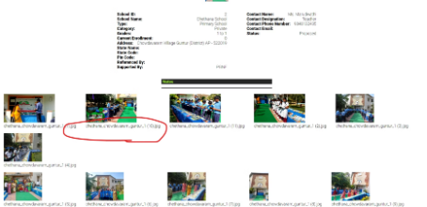
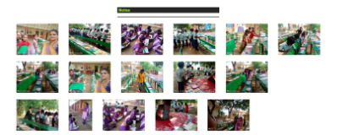
School details
As a user/visitor
When a user/visitor clicks on a school they're interested in they will see a more detailed information about that school
What we implemented/changed
We removed the file names for the images

Slide 14
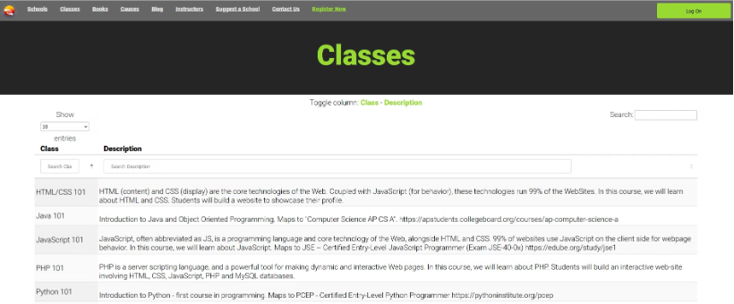
Classes
As a user/visitor
When a user/visitor clicks on classes they will see a list of classes and its description.
What we implemented/changed
Classes data pulled from Database as it was static before.

Slide 15
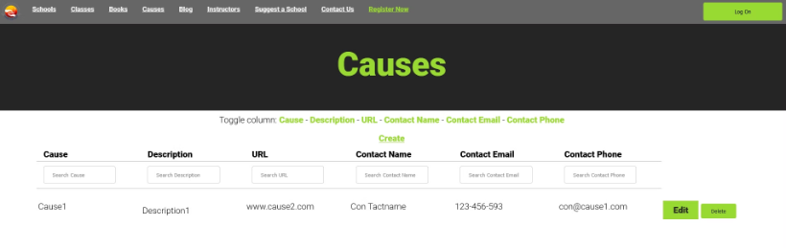
Causes
As a user/visitor
Here a user/visitor can create a new cause to help give more options of volunteering.
What we implemented/changed
No implementation was added/changed on "causes"

Slide 16
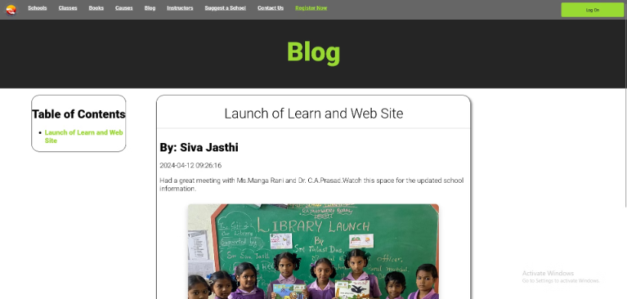
Blogs
As a user/visitor
In blogs users/visitors can see blogs written by admins or teacher talking about what is new and happening.
What we implemented/changed
Our team didn't change anything

Slide 17
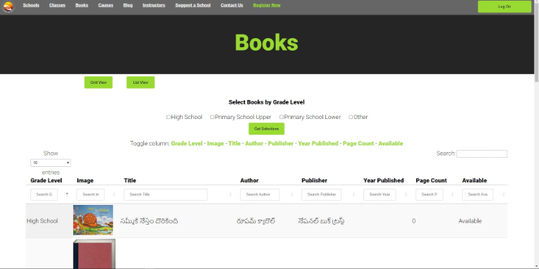
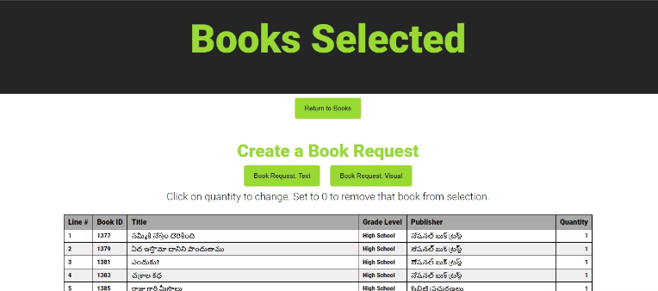
Books
As a user/visitor
Users/visitors can browse, view details, request, and filter books by grid, list, details, and grade levels.
What we implemented/changed
We implemented two buttons that changes the view from either a grind view or a list view

Slide 18
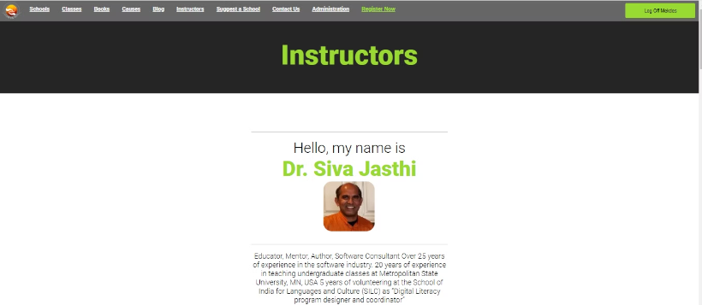
Instructors / Meet Instructors
As a user/visitor
User/visitors can view a list of instructors that are teaching courses on the Learn and help website
What we implemented/changed
Instructor data pulled from Database as it was static
Changed toolbar name from "Meet our Instructors" to "Instructors".
Users can view all instructors and read their biography.

Slide 19
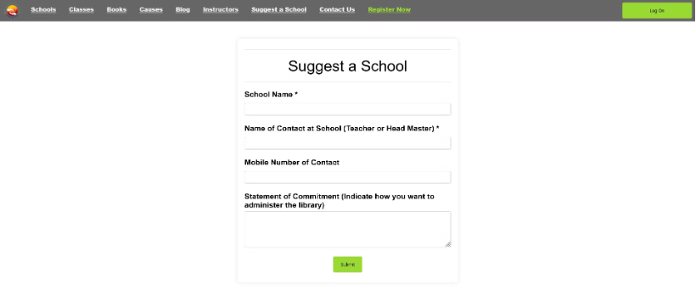
Suggest a School
As a user/visitor
A user/visitor can suggest their own school or a school they know that can provide more hands on experience.
The suggested school then sent to the admin
What we implemented/changed
We implemented a form that the user/visitor uses to send the suggested school.

Slide 20
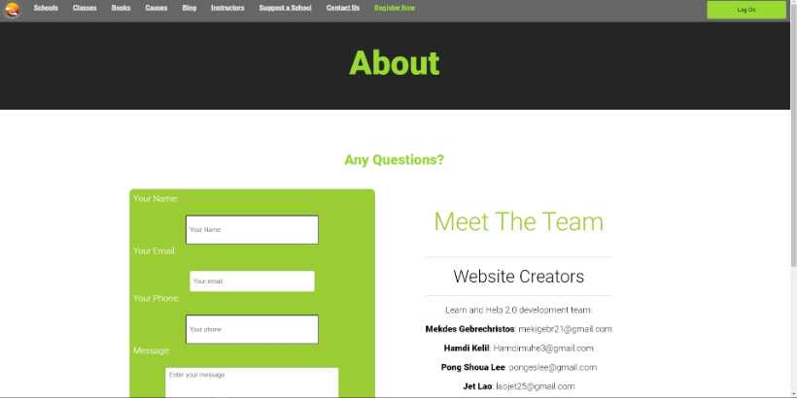
Contact Us
As a user/visitor
Users/visitors can send an email about any questions to an admin about anything related to the website or to receive more information on certain topics
What we implemented/changed
Updated Form
Every admin gets the Contact Us form data via email
Fixed link to Learn & Help PDF
User can send an email to admins about questions they have

Slide 21
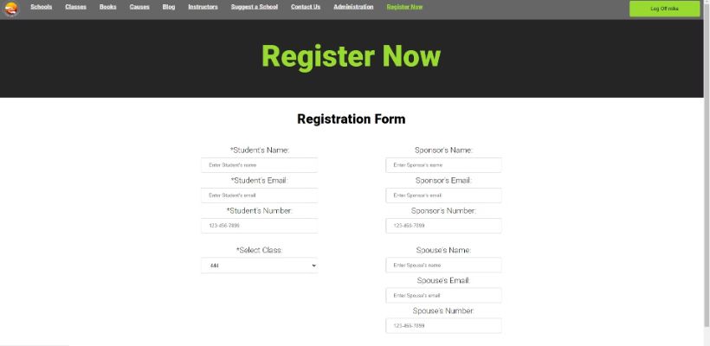
Register Now
As a user/visitor
As a user they can register for a class
If a visitor is to click on the "Register now" button it will take them to the login page to either login or create a account.
What we implemented/changed
Requires registered user to View
Updated Form data.
Form pulls in "Approved Classes" for user to select (was static content)

Slide 22
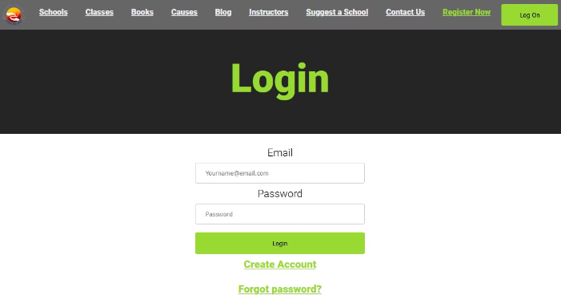
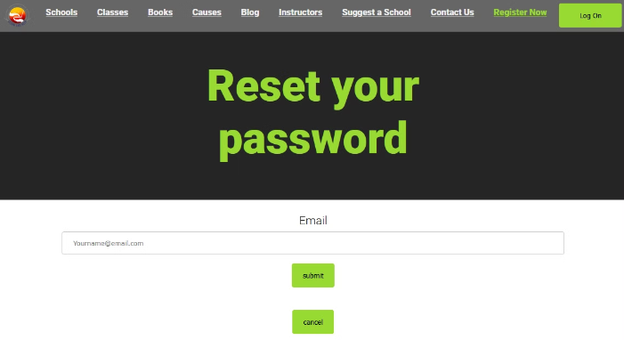
Reset Password
As a user/visitor
If a user forgets their password they can request one by clicking on the forgot password which will then prompt them to follow a couple of steps to reset their password
What we implemented/changed
Implemented forms with password reset functionality, enchanting new format: eight characters including six numbers, one lowercase letter, and one symbol, with hashed token validation and existing email database check.

Slide 23
Administrator Functionality

Slide 24
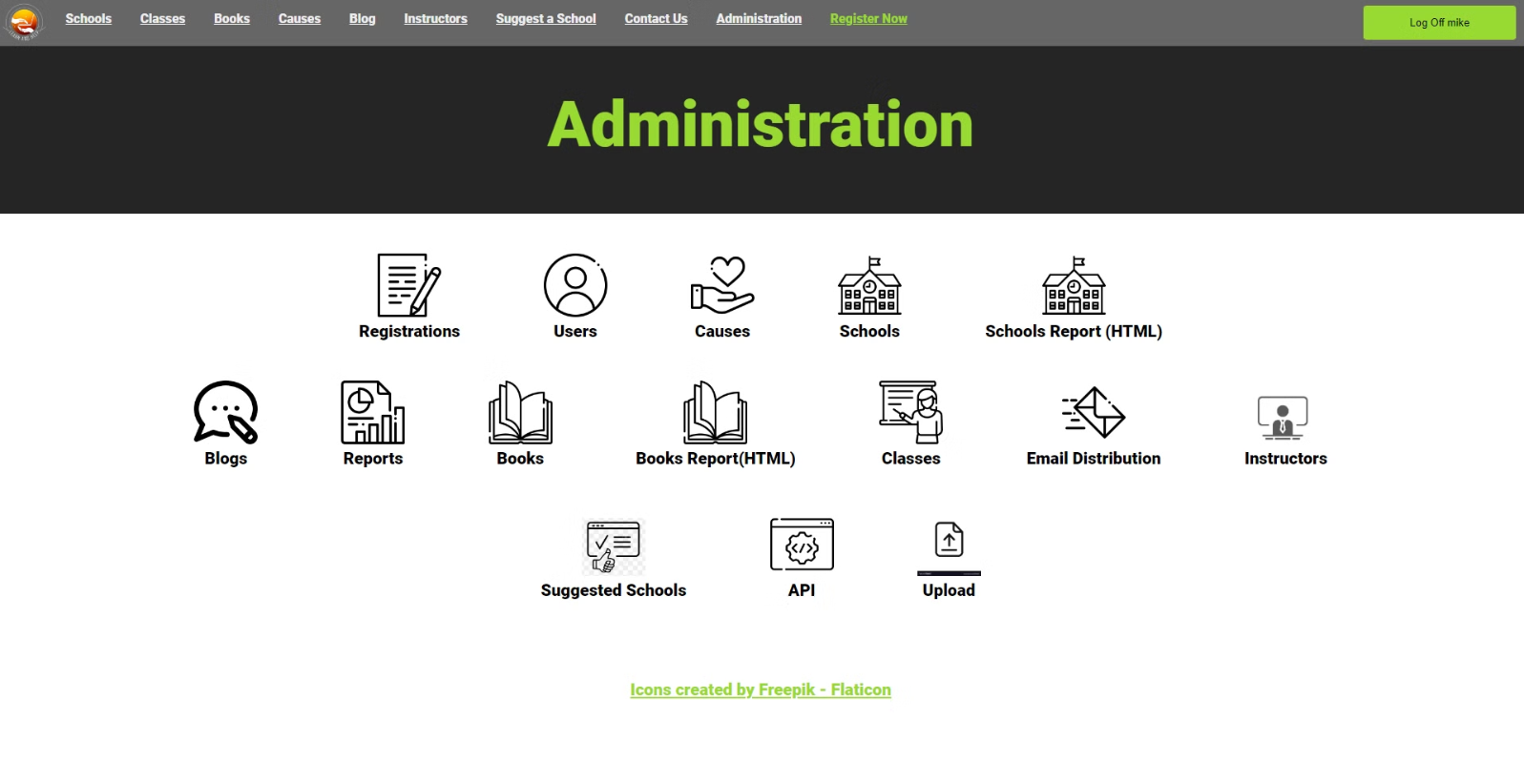
Administration Page

Slide 25
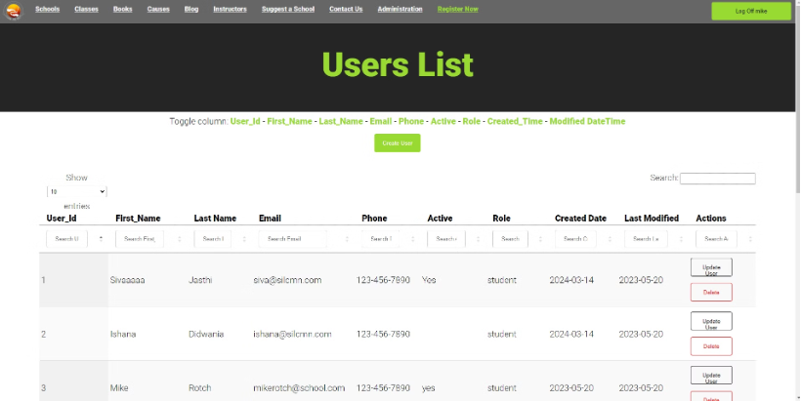
Users
As an admin
Admin can view all users
Admin can view instructors, students, and admins
Admins can create a new user
Added Team Member names, emails, phone numbers, etc..
Admins can delete users
On the top there's a toggle for columns to better organize what the admin is looking for
Delete protection (prompt/warning)

Slide 26
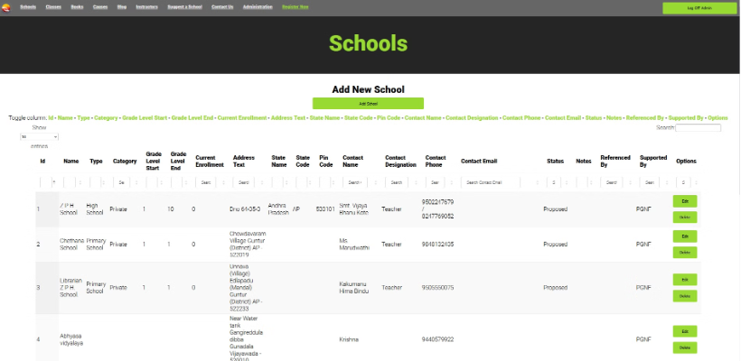
Schools
As an Admin
Admins can see all the schools that are registered
Admins can edit school details
Admins can delete school details
What we implemented/changes
Added CRUD operations, Added Profile Picture, Moved Options selector to be visible, Image upload functionality.

Slide 27
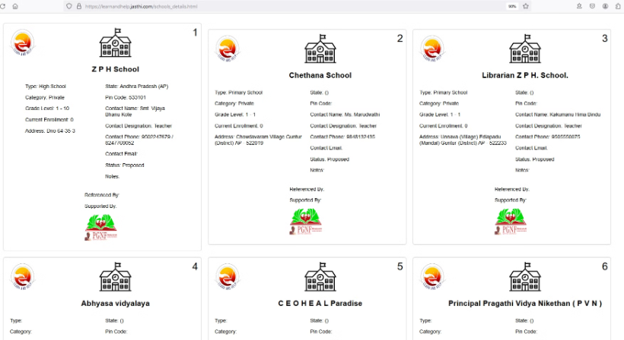
Schools Report (HTML)
As an Admin
Admin can open file from icon (Administrator Page)
More detail information for each school registered.
What we implemented/changed
Added missing (logos)
Logos updated

Slide 28
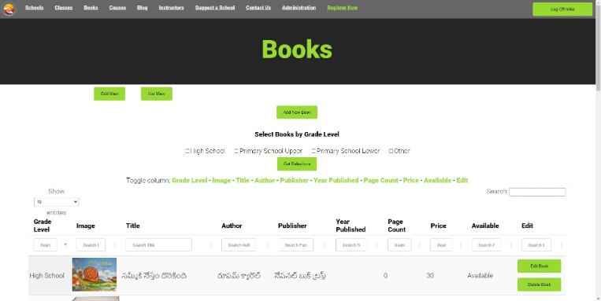
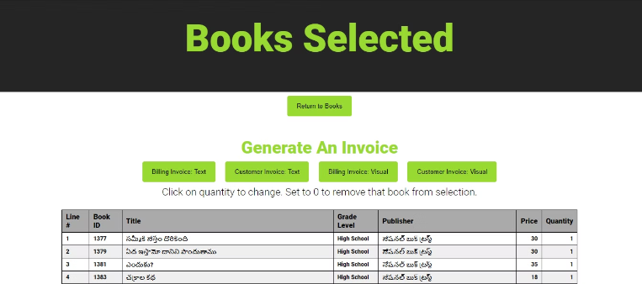
Books
As an Admin
Admin can view books by grade level
Admin can generate an invoice for customers
What we implemented/changed
Added 'Grid View' and 'List View' Buttons
Button function linked to appropriate view
Consolidated Web Pages - Content unchanged
Removed 'Books (Grid)' from Toolbar
Added Filter (Grid vs List view), modified filter/sort by Grade Level

Slide 29
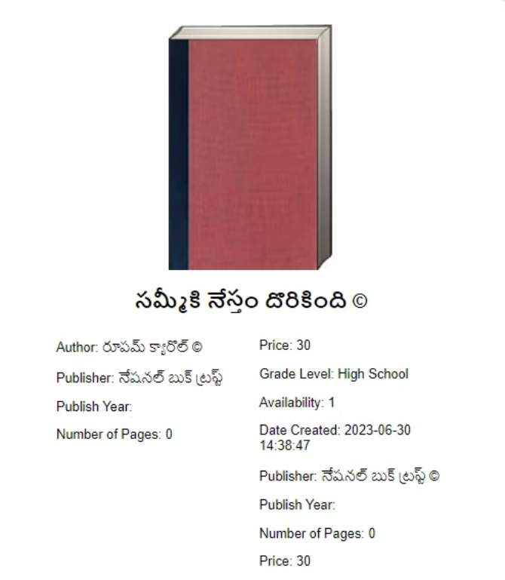
Book Report
As an Admin
Admin can view the book details
What we implemented/changed
Added unicode for language support, & accessibility
Added protection of copyright law

Slide 30
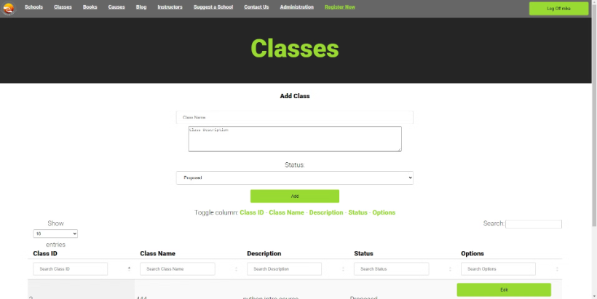
Classes
As an Admin
Allows Admin to perform CRUD operations on Classes.
What we implemented/changed
Added "Status" drop-down (Approved, Proposed, Inactive)
Added Delete protection (prompt/warning)
Form fields were made adjustable

Slide 31
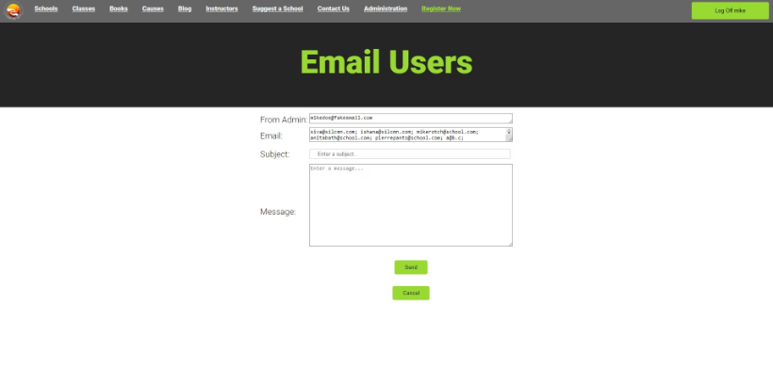
Email Distribution
As an Admin
Can send email to all registered users
All Admins get the same email
What we implemented/changed
Updated Form fields to adjustable
Added Send & Cancel buttons
All Emails pulled in from database.
Added email Icon (Administrator Page)

Slide 32
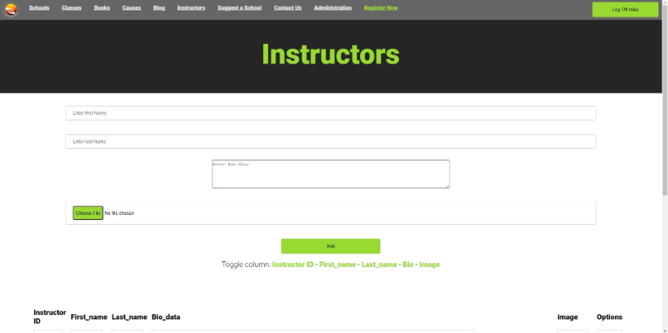
Instructors
As an Admin
Can perform CRUD operations (Was static info before)
What we implemented/changed
Added Instructors Icon to (Administrator Page)
Ability to upload a image as profile
Added Edit/Delete buttons Instructors.
Added columns as shown
Added provisions in database
Added Delete protection (prompt/warning)

Slide 33
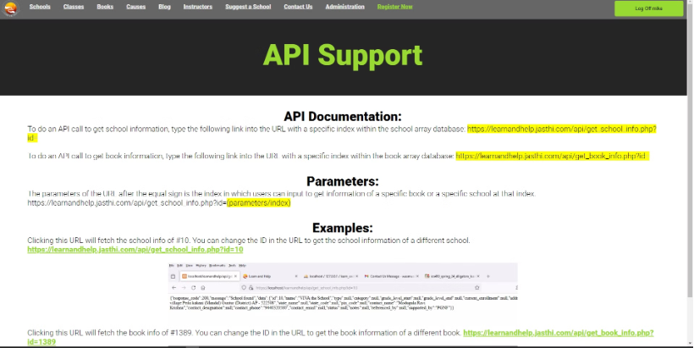
API
As an Admin
Admin can read how to use API to get information about school and books.
Admin can view data information by clicking on the links to the examples (JSON format)
What we implemented/changed
Added API Icon (Administrator Page)
Added associated webpage and images

Slide 34
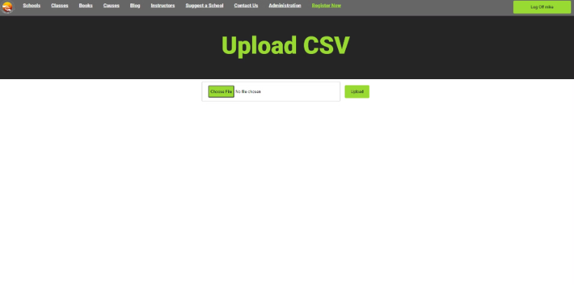
Upload CSV
As an Admin
Can update database with school information via a CSV file (e.g address, phone numbers, etc.)
What we implemented/changed
Upload Icon (Administrator Page)
Linked icon to existing webpage
Functionality remains unchanged

Slide 35
Q & A
Thank you !

